Slide 1
Chapter 3
Structured Analysis
Software Analysis and Design
0721322

Slide 2
Introduction
The analysis model must achieve three primary objectives :
1. to describe what the customer requires
2. to establish a basis for the creation of a software design
3. to define a set of requirements that can be validated once the software is built.
The analysis model bridges the gap between system-level description that describes overall system functionality and system design.

Slide 3
Introduction
Two different modeling philosophies can be applied:
- Structured analysis :
  Considers data and the process that transform the data as separate entities.
  Views software as an information transformer.
  Assists the software engineer in identifying data objects, their relationships, and the manner in which those data objects are transformed.
- Object-oriented analysis :
  Focuses on the definition of classes and the manner in which they collaborate with one another to affect customer requirements.

Slide 4
Structured Analysis Model Elements
Data flow diagram (DFD) - provides an indication of how data are transformed as they move through the system; also depicts functions that transform the data flow.
Entity relationship diagram (ERD) - depicts relationships between data objects
Data dictionary - contains the descriptions of all data objects consumed or produced by the software
State diagram (SD) - indicates how the system behaves as a consequence of external events, states are used to represent behavior modes. Arcs are labeled with the events triggering the transitions from one state to another (control information is contained in control specification or CSPEC)

Slide 5
Flow-oriented modeling
Flow-oriented modeling shows how data are transformed inside the system by processing functions.
Creating a Data Flow Model :
The Data-flow models are used to show how data objects flow
through a sequence of processing steps.
Creating a Control Flow Model :
Represents “events” and the processes that manage events.

Slide 6
Creating a Data flow Model
The data flow diagram enables the software engineer to develop models of the information domain and functional domain.
Data-flow modeling is a core modeling activity in structured analysis.
DFDs model the system from a functional perspective
Tracking and documenting how the data associated with a process is helpful to develop an overall understanding of the system
Data flow diagrams may also be used in showing the data exchange between a system and other systems in its environment.
DFD's cannot show procedural detail (e.g., conditionals or loops) only the flow of data through the software

Slide 7
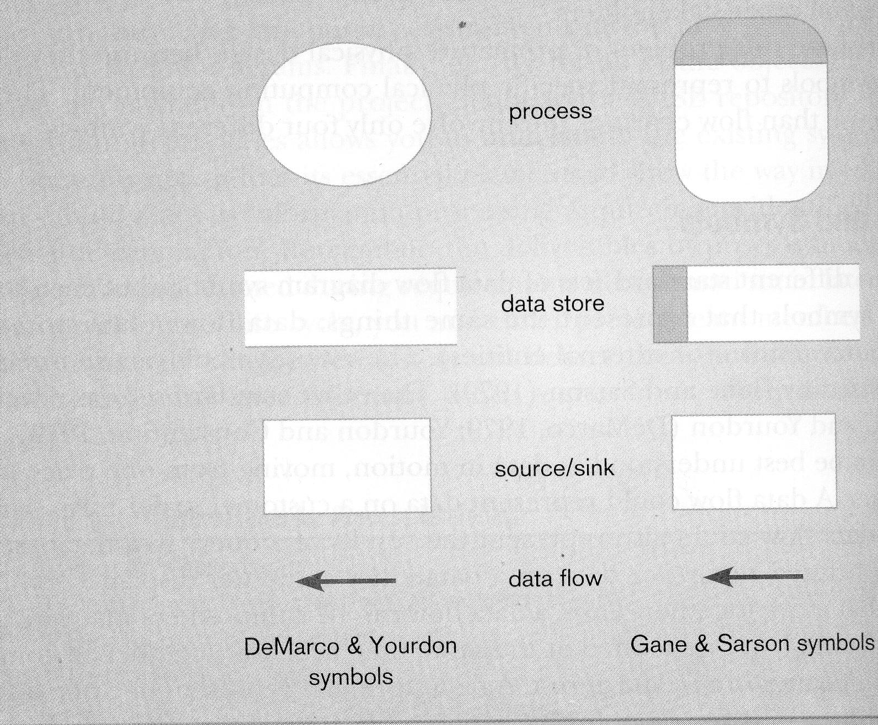
Creating a Data flow Model

Slide 8
Levelled DFDs
Break each process down into sub-processes
Numbering of processes indicates their parents process, and thus their position in the hierarchy of levelled DFDs0

Slide 9
Levelled DFDs
Context Diagram
A data flow diagram (DFD) of the scope of an organizational system that shows the system boundaries, external entities that interact with the system and the major information flows between the entities and the system
- Indicate the people, organisations and systems which communicate with our system
- Show the data which our system receives from the outside world
- Show the data produced by the system and sent to the outside world
- Show the data which is shared by the system with the outside world
- Show the boundary between the system and the rest of the world
Level-O Diagram
A data flow diagram (DFD) that represents a system’s major processes, data flows and data stores at a high level of detail

Slide 10
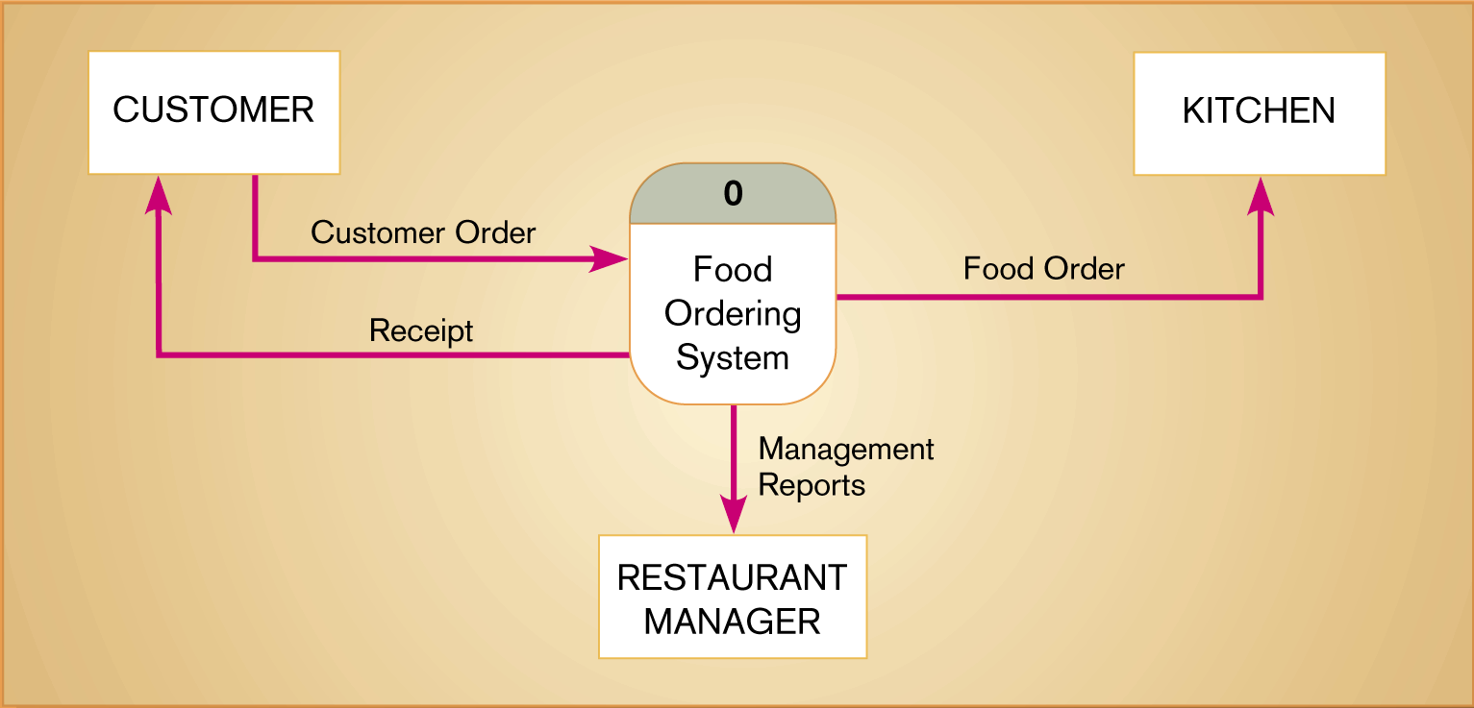
Context diagram of Hoosier Burger’s food ordering system

Slide 11
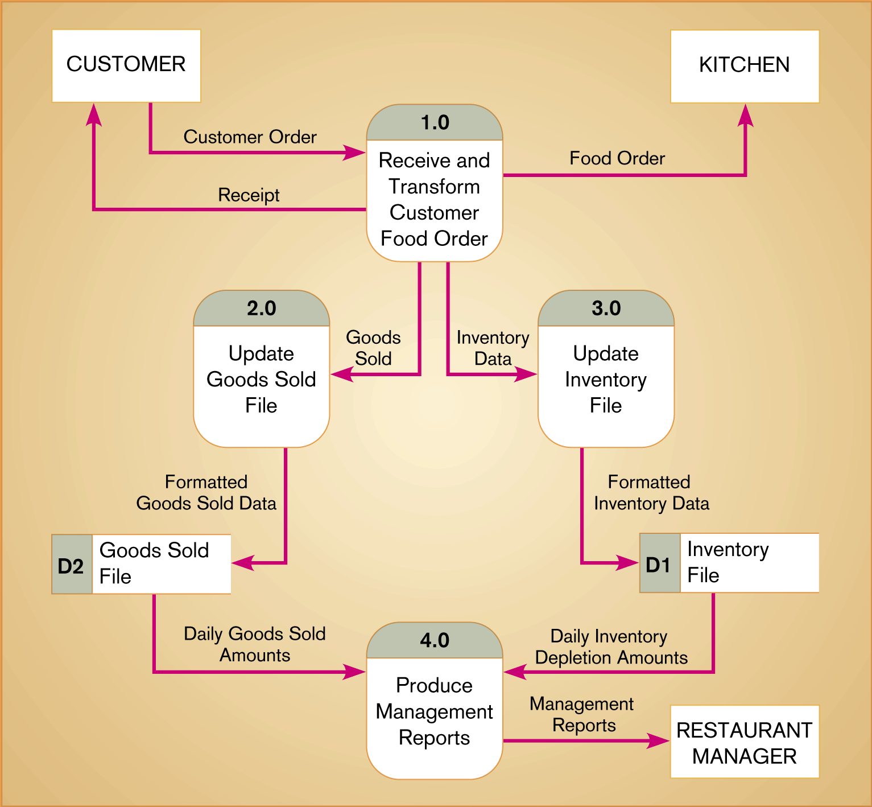
Level-0 DFD of food ordering system

Slide 12
Process Specifications
Data flow diagrams do not show the logic inside the processes
Logic modeling involves representing internal structure and functionality of processes depicted on a DFD
All bottom level processes are specified
The specifications may be
  Structured English
  Pre/Post Conditions
  Decision Tables
Need to be more formal and specific than normal English
Need to be easily understandable by the user
Should not impose arbitrary design or implementation decisions

Slide 13
Process Specifications and DFDs
CONTEXT DIAGRAM
Figure 2 DFD
Note:
Process 2.3 is a lowest-level process
Note:
Observe that Figures 0 and 2 are balanced w.r.t. incoming and outgoing dataflows
2.2
2.1
2.3
Process Spec for Level 2.3
kahgdkljhckldsajcaljscaljljakdclnh
kljclkjcl;kjcl;asjca;sjcjc;kkdj;jsa;k
ckjal;kjcalkjcal;jcaljcal;kjckljcakj
if kjc = mjclakj
then
do
ldclscknlskld
else
jhalkscjl
lnhclsncdslnc
end - specification
1
2
Figure 0
DFD
3
4
Process
Specification
for Process 2.3

Slide 14
Structured English
Subset of English with restrictions on usage
Each sentence must be as follows:
  an algebraic equation e.g. X = (Y*(Z+2))/Q+14
  or consist of a simple imperative sentence with a verb and an object
    e.g. READ next Order
    e.g. DISPLAY Result to Screen
  Can use IF … THEN … ELSE construction
  Can use CASE construction
  can use LOOP construction
  Object must be defined in the analysis (i.e. in Data Dictionary) or must be a local term defined for that process only

Slide 15
An example
Calculate Tax Rate - Process Specification in Structured English
IF goods are Taxable
DO CASE
CASE goods-type = “Food”
SET tax-rate to 0
CASE goods-type = “Vehicle”
SET tax-rate to 20
CASE goods-type = “Clothes”
SET tax-rate to 40
OTHERWISE
SET tax-rate to 15
ENDCASE
ELSE
WRITE Tax not applicable to Results data store
ENDIF

Slide 16
An example
Process 1.0: Update Inventory Added
Do
READ next Invoice-item-record
FIND matching Inventory-record
ADD Quantity-added from Invoice-item-record to Quantity-in-stock on inventory-record
UNTIL End-of-file
Process 2.0: Update Inventory Used
Do
READ next Stock-item-record
FIND matching Inventory-record
SUBTRACT Quantity-used on Stock-item-record from Quantity-in-stock on inventory-record
UNTIL End-of-file

Slide 17
Pre and Post Conditions
Describe the process without specifying the algorithm
Useful approach when
  need to get away from existing method of performing the task
  there may be many possible algorithms to use
  want to let the implementer explore the values of various algorithms

Slide 18
Pre Conditions
Describe what must be true before the process begins operating:
  What inputs must be available
    e.g. Account Number exists
  What relationships exist between inputs or within inputs
    e.g. Purchase Order account number is the same as the Customer account number
  What relationships exist between inputs and data stores
    e.g. There is a Customer with that account number in the Customer data store
  What relationships exists between different stores or within a single store
    e.g. there is a purchase order in the Purchase Order data store with the current date

Slide 19
Post Conditions
Describe what must be true when the process is completed:
  The outputs that will be generated by the process
    e.g. An invoice will be generated
  The relationship between the output and the original input values
    e.g. invoice-total will equal the sum of the unit prices multiplied by number ordered plus shipping-costs
  Relationships between output values and values in one or more stores
    e.g. The number-remaining for each item in the Inventory data store will be reduced by the amount-ordered for each item
  The changes that will have been made to stores
    e.g. A new record will be appended to the Invoice data store

Slide 20
Modeling Logic with Decision Tables
A matrix representation of the logic of a decision
Used when the process result is based around several different variables and the logic gets too complex for other methods
Specifies the possible conditions and the resulting actions
Best used for complicated decision logic
Consists of three parts
  Conditions
    Lists condition relevant to decision
  Actions
    Actions that result from a given set of conditions
  Rules
    Specify which actions are to be followed for a given set of conditions

Slide 21
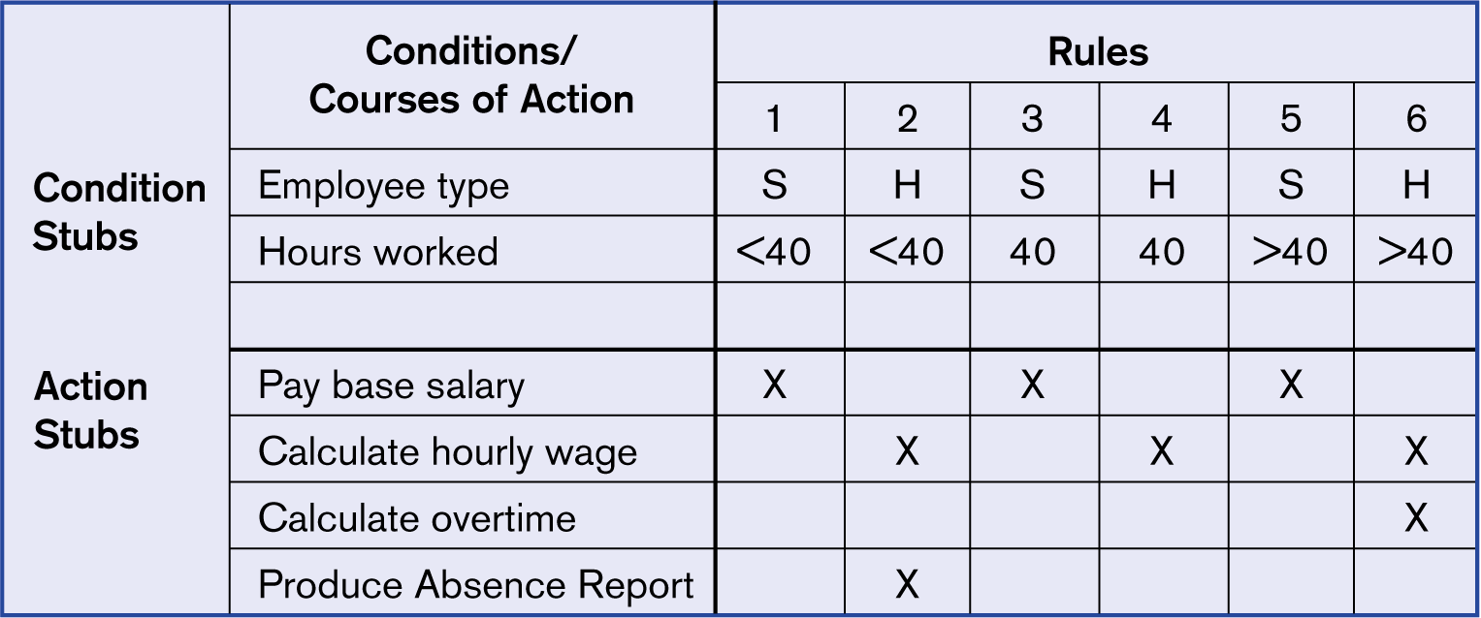
Complete decision table for payroll system example

Slide 22
Example

Slide 23
Entity-Relationship Diagrams
Model the relationships between data in the system
Highlight the relationships between data stores directly
  When using ERD for data modeling, only relationships that are represented in the data stores (e.g. via a foreign key) should be shown
Very useful in relational database systems
Often more central to your system than DFDs
4 Components
  Entity types
  Relationships
  Associative entity types
  Supertype/subtype indicators

Slide 24
Entity Types
A collection of entities whose individual members have the following characteristics:
  Each can be uniquely identified in some manner
  Each plays a necessary role in the system we are building
  Each can be described by one or more data elements
Customer
CHARACTERISTICS
Has a Customer Number
Is necessary for a sales system
Described by elements such as name, address, customer number, phone, number, credit rating etc.

Slide 25
Relationships
COUNTRY
CAPITAL
has
One to One Relationship
CUSTOMER
ITEM
purchases
One to Many Relationship
COMPANY
SUPPLIER
supplies
Many to Many Relationship

Slide 26
Associative Entities
Sometimes it is necessary to store data about a relationship
We then need to turn the relationship into an entity
We might want to keep track of date of purchase, method of purchase, location of purchase, none of which fit into the Customer or Item entity
So we create a Purchase entity
Note that Customer and Item exist regardless of any Purchase
Purchase only exists as a result of the relationship between the other two
CUSTOMER
ITEM
purchases
Customer
Item
Purchase

Slide 27
Supertypes/Subtypes
Often there are different types of a basic entity
For example if we have a CUSTOMER entity, but we keep different information on customers using cash and customers using credit we could specify it as follows:
Customer
Cash
Customer
Credit
Customer

Slide 28
E-R Diagram Guidelines
If all data elements in an entity don’t apply to all instances, think about creating subtypes
Carefully examine to see if associative entities are needed
Modify the diagram when:
  Consist only of an identifier and have no data elements
  Have only one instance in the system
  Can derive the information and thus the relationship is unnecessary
Remember that ER-Diagrams are for modelling data stored in the system
  There is no need to show external entities about which no data is stored

Slide 29
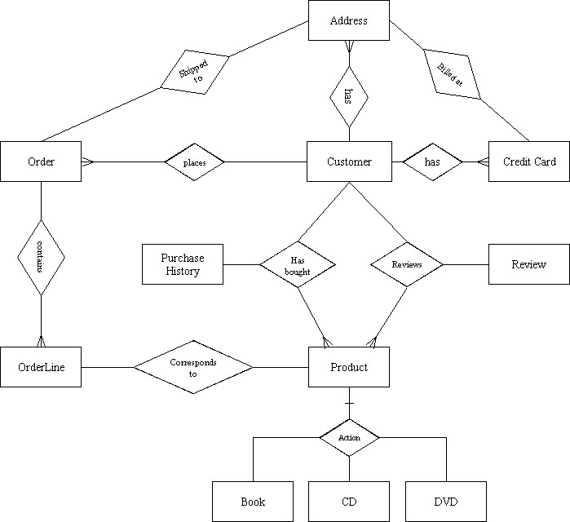

Slide 30
Data dictionaries
Data dictionaries are lists of all of the names used in the system models. Descriptions of the entities, relationships and attributes are also included
Advantages
  Support name management and avoid duplication
  Store of organisational knowledge linking analysis, design and implementation

Slide 31
Data Dictionary Contents
Name - primary name for each data or control item, data store, or external entity
Alias - alternate names for each data object
Where-used/how-used - a listing of processes that use the data or control item and how it is used (e.g., input to process, output from process, as a store, as an external entity)
Content description - notation for representing content
Supplementary information - other data type information, preset values, restrictions, limitations, etc.

Slide 32
Data Dictionary Notation
= is composed of
+ and
( ) optional ( may be present or absent)
{ } iteration
[ ] select one of several alternatives
** comment
@ identifier (key field) for a datastore
| separates alternative choices in the [ ] construct

Slide 33
Data Dictionary examples
order = @order-id + customer-name + shipping-address + 1{item}10
orders = {order}
customer-name = courtesy-title + first-name + (middle-name)+ last-name
courtesy-title = [Mr. | Miss | Mrs. | Ms. | Dr. | Professor]
first-name = {legal-character}
middle-name = {legal-character}
last-name = {legal-character}
legal-character = [A-Z|a-z|0-9|’|-| |]
an order always has an order-id (which is the key field), a customer-name and a shipping-address, and has between 1 and 10 items.

Slide 34
State-Transition Diagrams
State-Transition Diagrams (STD) model time-dependent behavior. Many complex systems have time-dependent behaviour, that is, the sequence in which data will be accessed and functions will be performed
Have 4 components
  States : A state is usually denoted either with a rectangle or an oval. The state is labeled with a noun.
  Transitions : A transition is denoted by an arrow line connecting one state to another, with the arrow indicating the transition direction. The transition is labeled with a condition, and optionally a corresponding action. A condition is usually a noun phrase, while an action is most often a verb phrase.
  Conditions : A condition is an event in the external environment which triggers a transition to a new state
  Actions : An action is a response sent back to the external environment or a calculation whose result is stored by the system that occurs when the transition takes place
Can be levelled like DFDs
Must have one initial state and may have multiple final states

Slide 35
Answering Machine Example: states and transitions
Idle
Waiting
for call
Recording
Message
Rewinding
Playing
Messages
Answering
Call
Note: this STD is incomplete: conditions and actions are not shown

Slide 36
Example of conditions/actions
Idle
Condition
Condition
Press Answer button
Press Cancel button
Ready to receive light
goes on
Ready to receive button
goes out
Waiting for
Call
Action
Action
Incoming call detected
End of Call or tape runs out
Answering
Call
Condition
Condition

Slide 37
Microwave oven model

Slide 38
Microwave oven state description

Slide 39
Integrating the Models
Structured Analysis consists of many different models
Each model focuses on one aspect of the system
Often hard to see the connections between the different models, resulting in inconsistencies
Need an approach to check each model against the other models

Slide 40
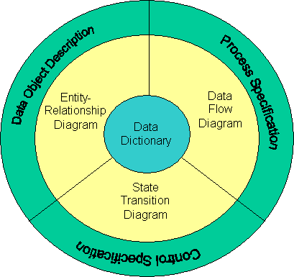
- The structured analysis model.

Slide 41
Extra remarks

Slide 42
Structured analysis and structured design (SASD) may be approached in the following manner:
Environmental modeling: defines the boundary between the system and the rest of the world (external objects) and consists of three different activities:
  context diagram
  event list
Functional/Behavioral modeling: The functional and behavioral model describes the required behavior of the insides of the system necessary to interact successfully with the environment
  data flow diagram
  process specification
  data dictionary
  entity relationship diagram
  state transition diagram
Implementation Modeling : The implementation model comprises the design portion of SASD
  structure charts
  considerations for modules
structured design

Slide 43
DFDs and the Data Dictionary
Every data flow (arrow on a DFD) and every data store must be defined in the data dictionary
Every data element and every data store must appear on a data flow diagram somewhere in the system
Every data store in the DFDs must correspond to an entity type or a relationship or an associative entity
Entity names and data store names must match. Use plural for data stores, singular for entities.

Slide 44
E-R Diagram and DFDs
CUSTOMERS = {Customer}
CUSTOMER = name + address + phone-number + …...
Data dictionary entities must apply to both the DFD model and the E-R model
Every Control bubble in a DFD must have an associated state-transition diagram as its process specification
Every condition in the state-transition diagram must correspond to an incoming control flow on the control bubble
Every action in the state-transition diagram must correspond to an outgoing control flow on the control bubble

